Slide 1


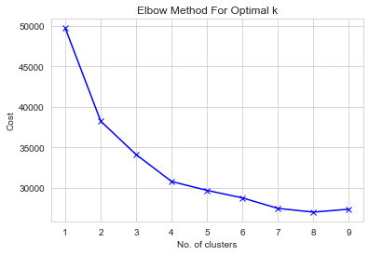
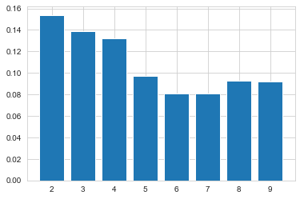
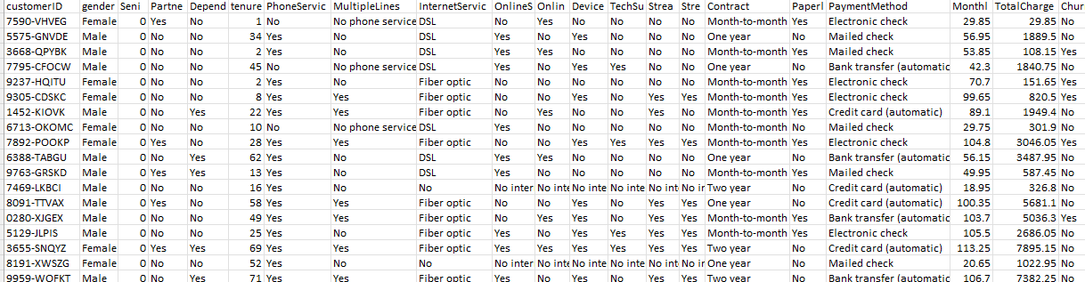
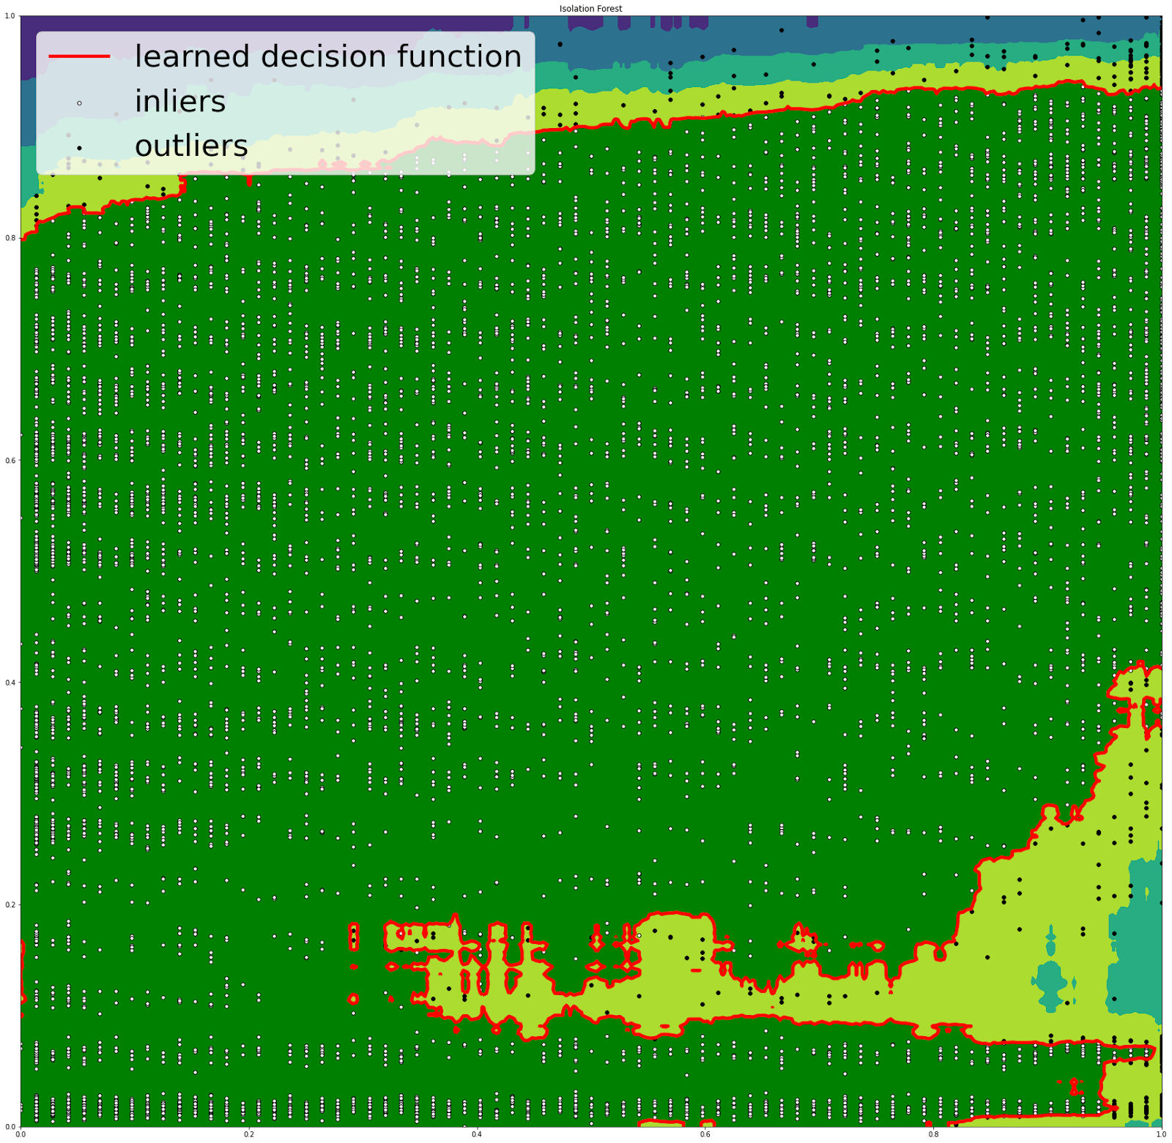
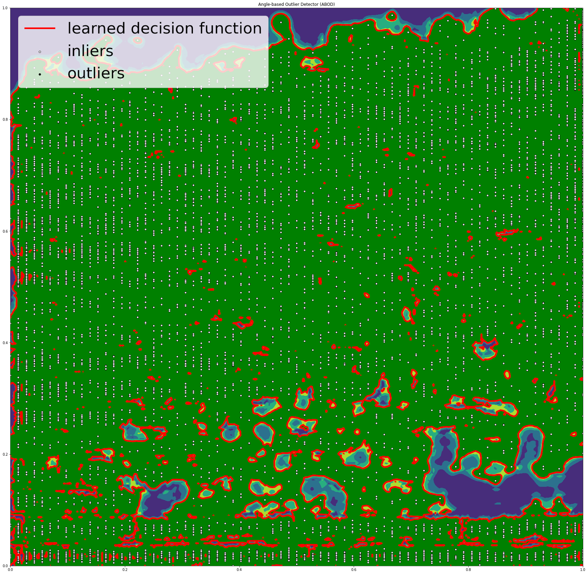
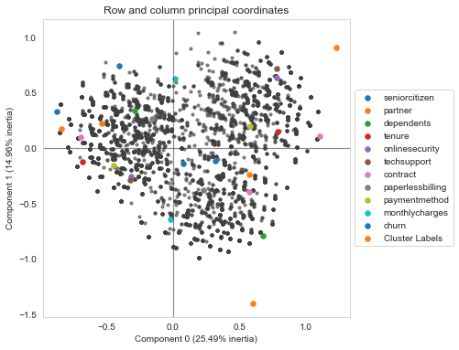
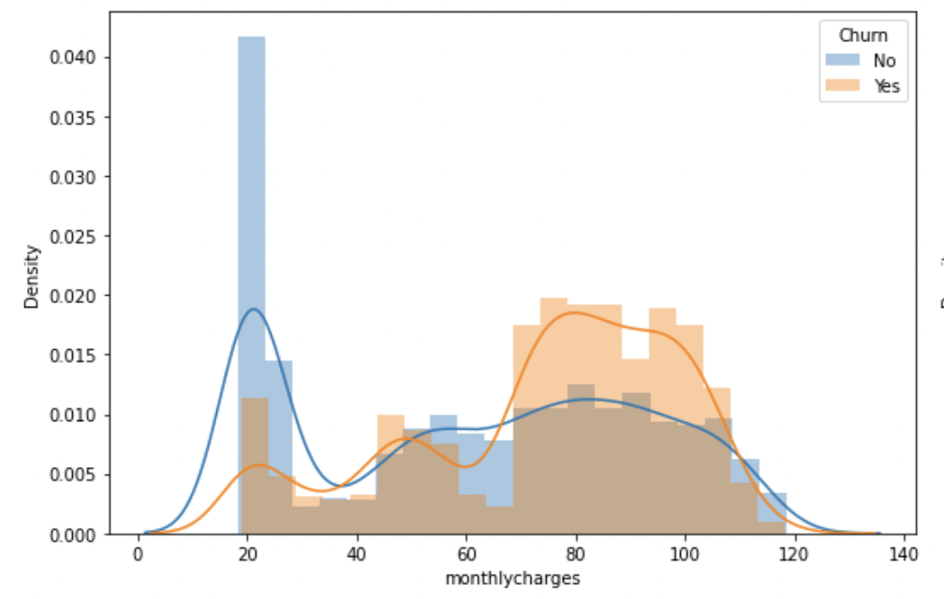
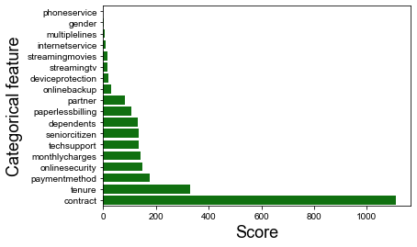
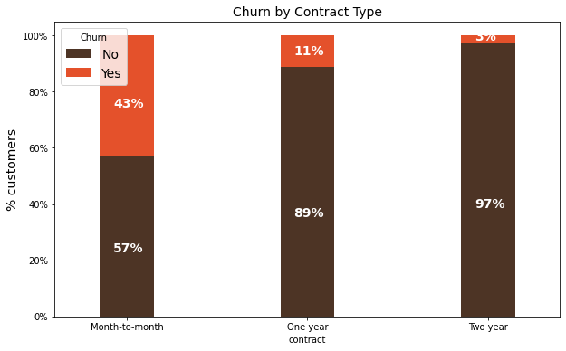
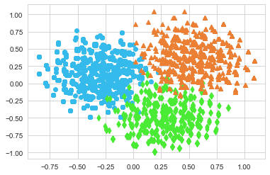
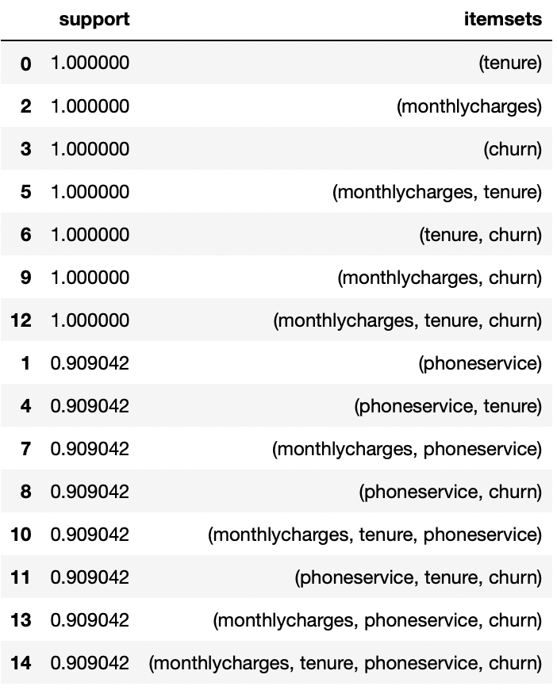
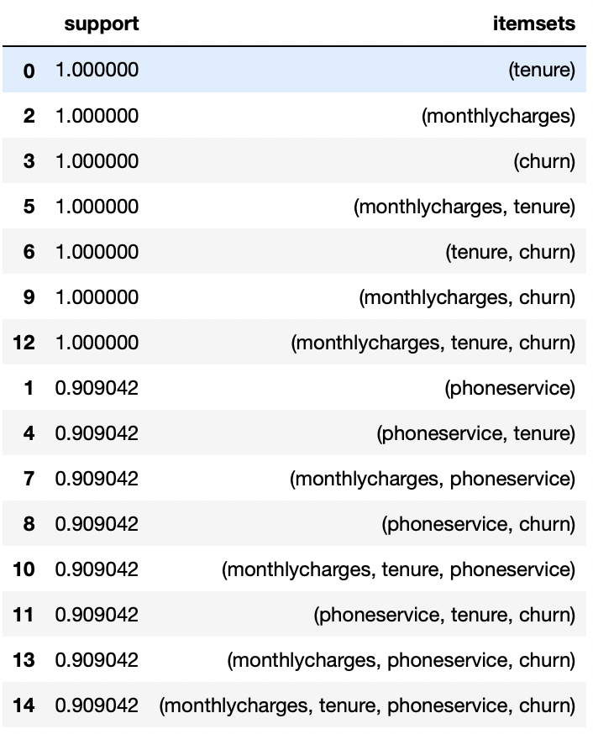
Telco Customer Churn
Problem Statement
Optimal Clusters
Interesting patterns and information from Telcom customer data set.
Clusters = 2,3
Rudraksh Mishra
Dataset
Department of Data Analytics, Penn State University Great Valley
Outlier Detection
Isolation forest ABOD
Elbow Method
Clusters = 3,4
Silhouette Method
MCA
Data Visualizations
Outliers: 423
Outliers: 0
Constructing a low-dimensional visual representation of categorical variable associations.
Feature Selection (Chi2)
High monthly charges
High probability of churning
Choose top 10 scores for best features
K modes
Month-to-month contract
High probability of churning
Association Rule

